Slide 1
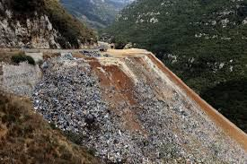
DURING THE 2015 WASTE CRISIS LAMARTINE VALLEY IN BEIT MERY ACCOMODATED THE GARBAGE OF ALL METN AREAS.

Slide 2
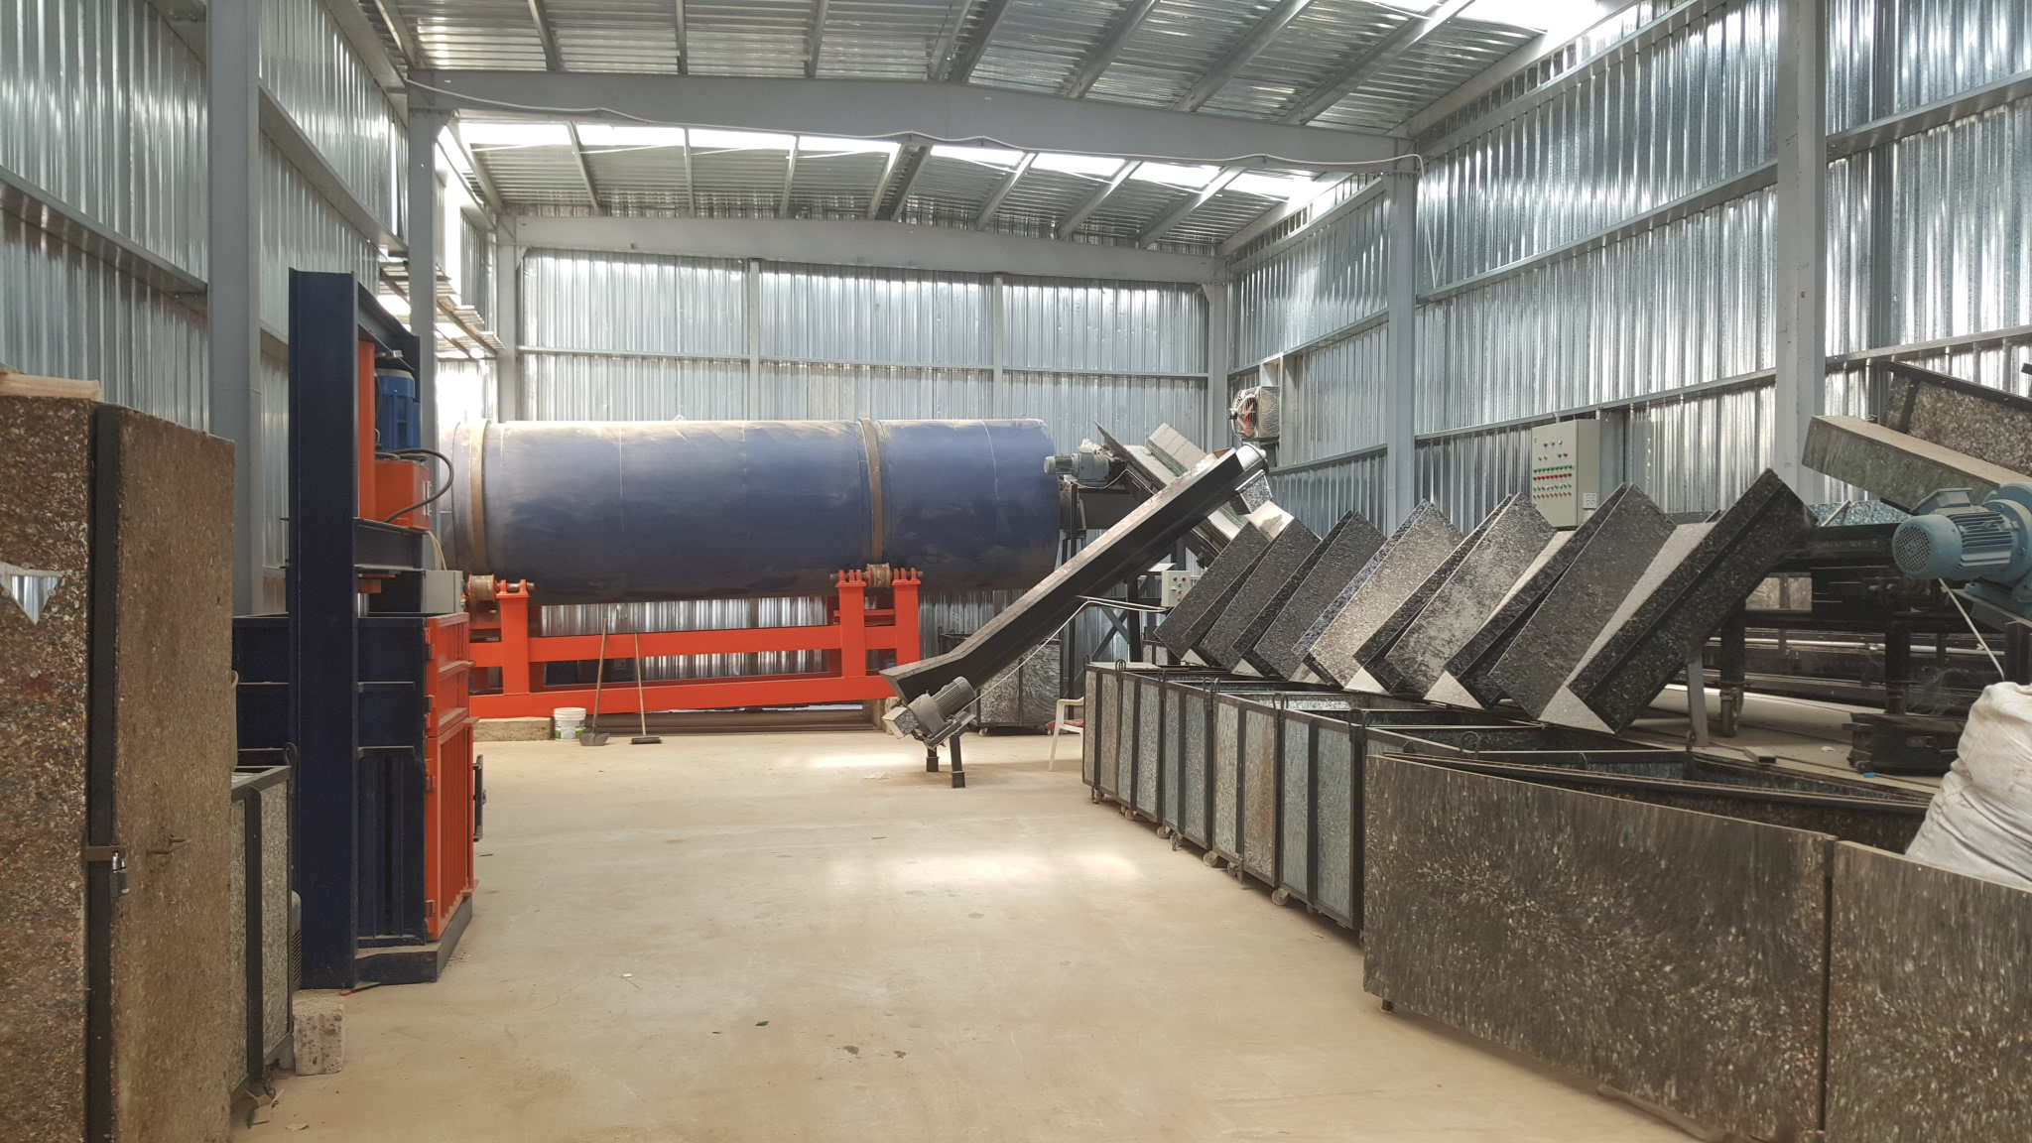
THE BEIT MERY ZERO WASTE RECYCLING PLANT
SORTING – COMPOSTING – RECYCLABLES PROCESSING

Slide 3
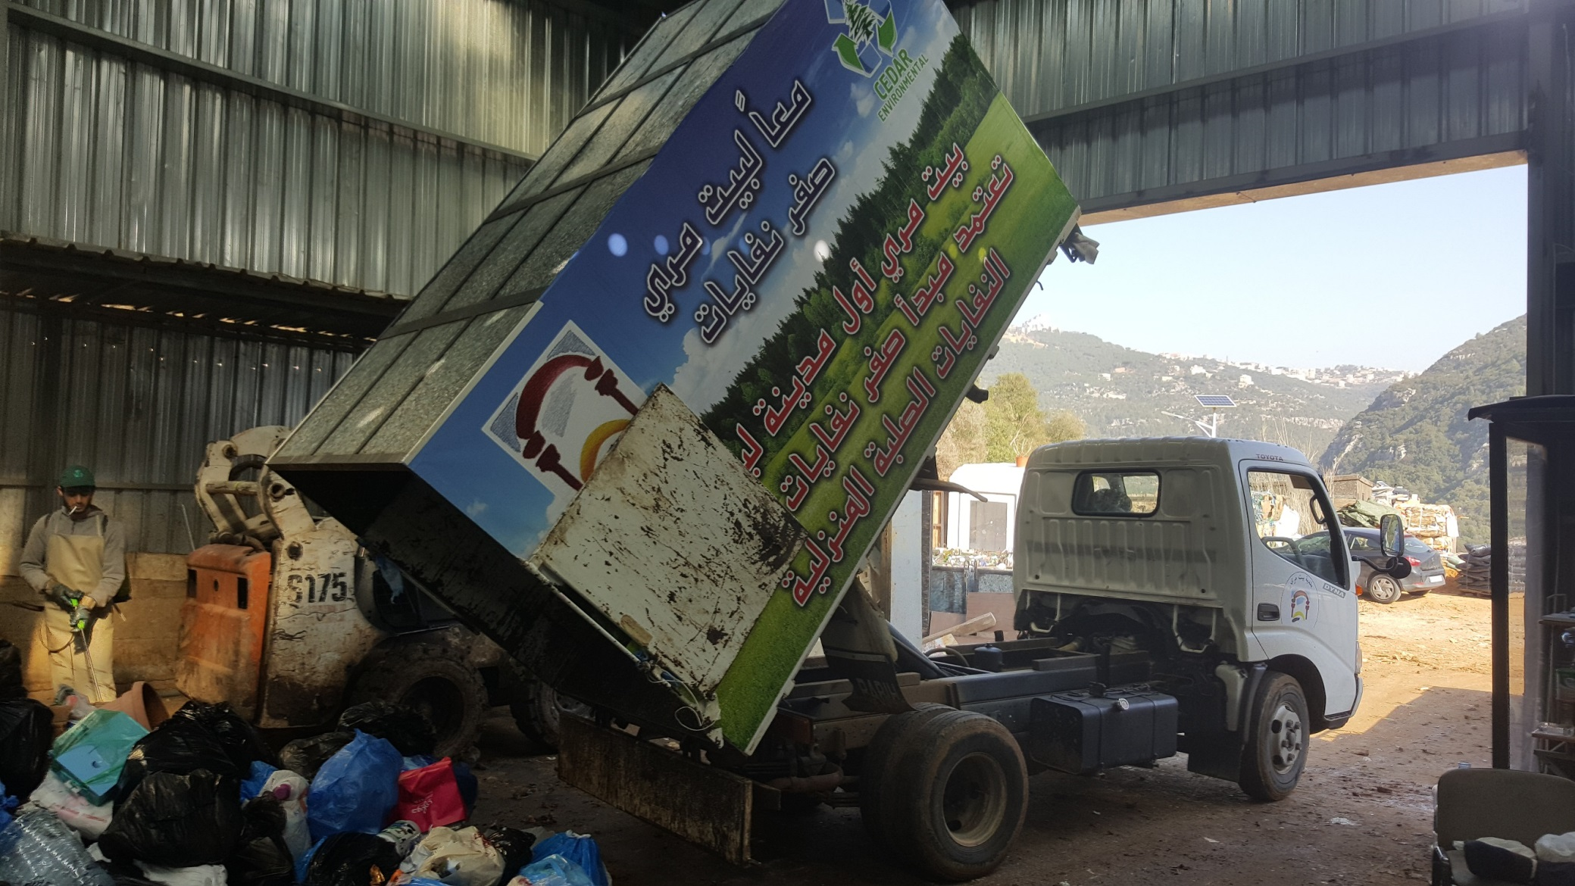
THE BEIT MERY ZERO WASTE RECYCLING PLANT
INCOMING TRUCKS UNLOAD THE WASTE IN THE RECEIVING ZONE

Slide 4
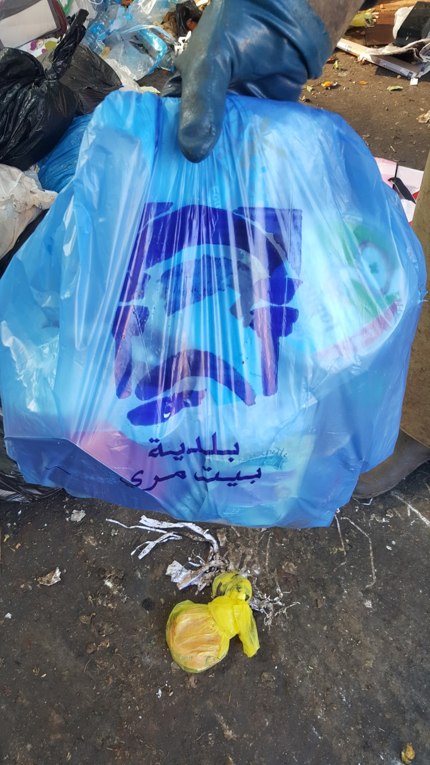
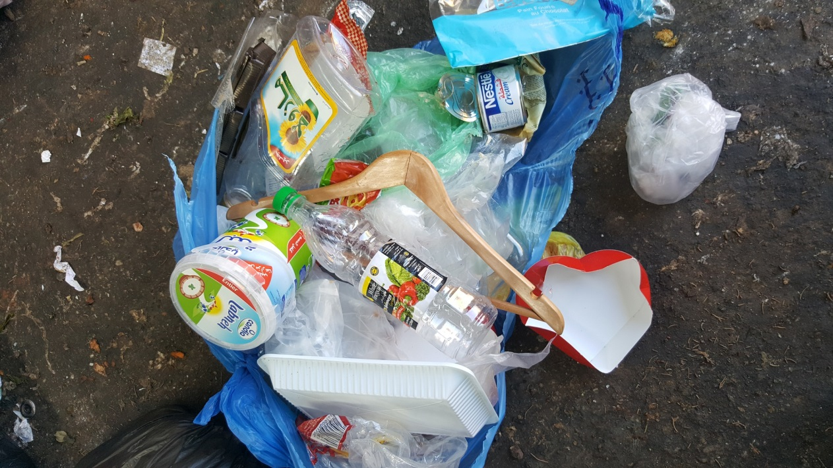
THE BEIT MERY ZERO WASTE RECYCLING PLANT
A 2 BAG SORTING SYSTEM IS IN PLACE TO HELP
REDUCE THE TIME OF SORTING AT THE PLANT.

Slide 5
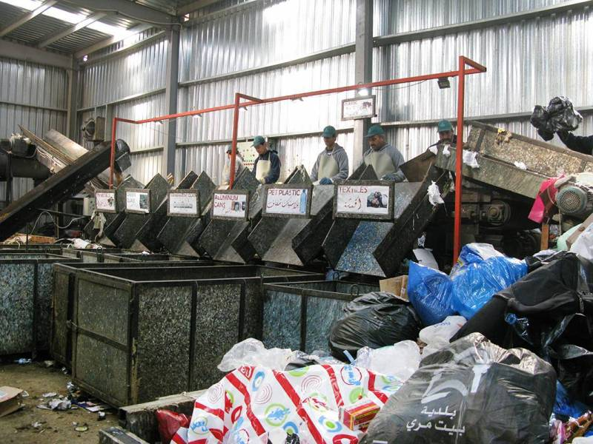
THE BEIT MERY ZERO WASTE RECYCLING PLANT
BAGS ARE OPEN AND RUN ON THE SORTING BELT

Slide 6
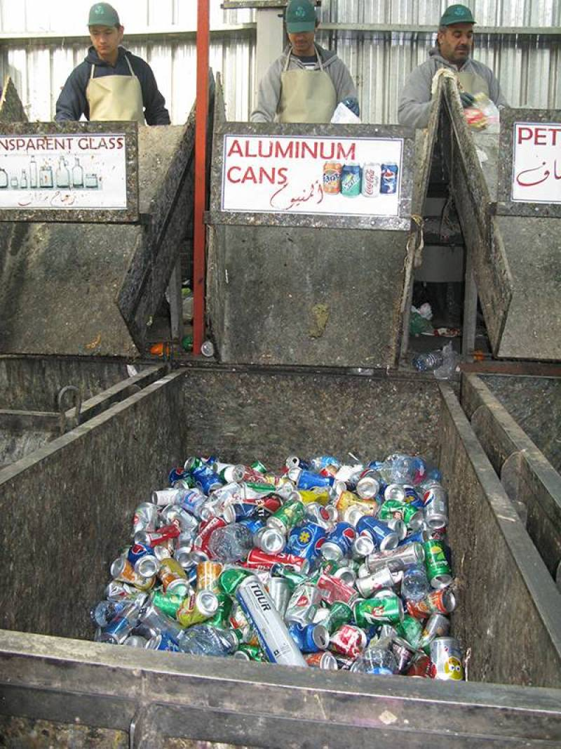
THE BEIT MERY ZERO WASTE RECYCLING PLANT
WASTE IS SORTED BY TYPE

Slide 7
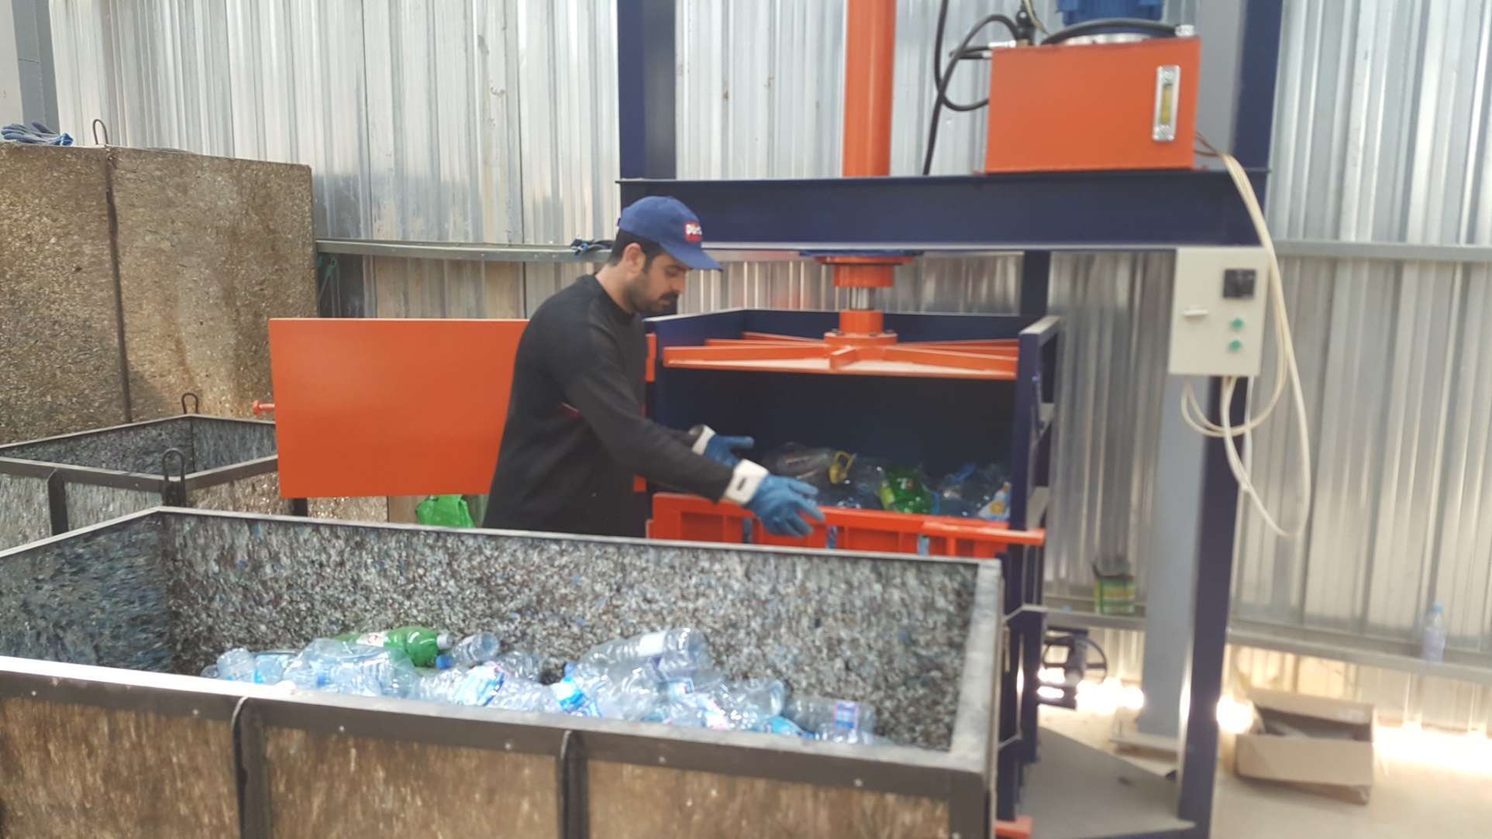
THE BEIT MERY ZERO WASTE RECYCLING PLANT
MOST WASTE IS BALED TO REDUCE ITS VOLUME TO SAVE ON TRANSPORTATION

Slide 8
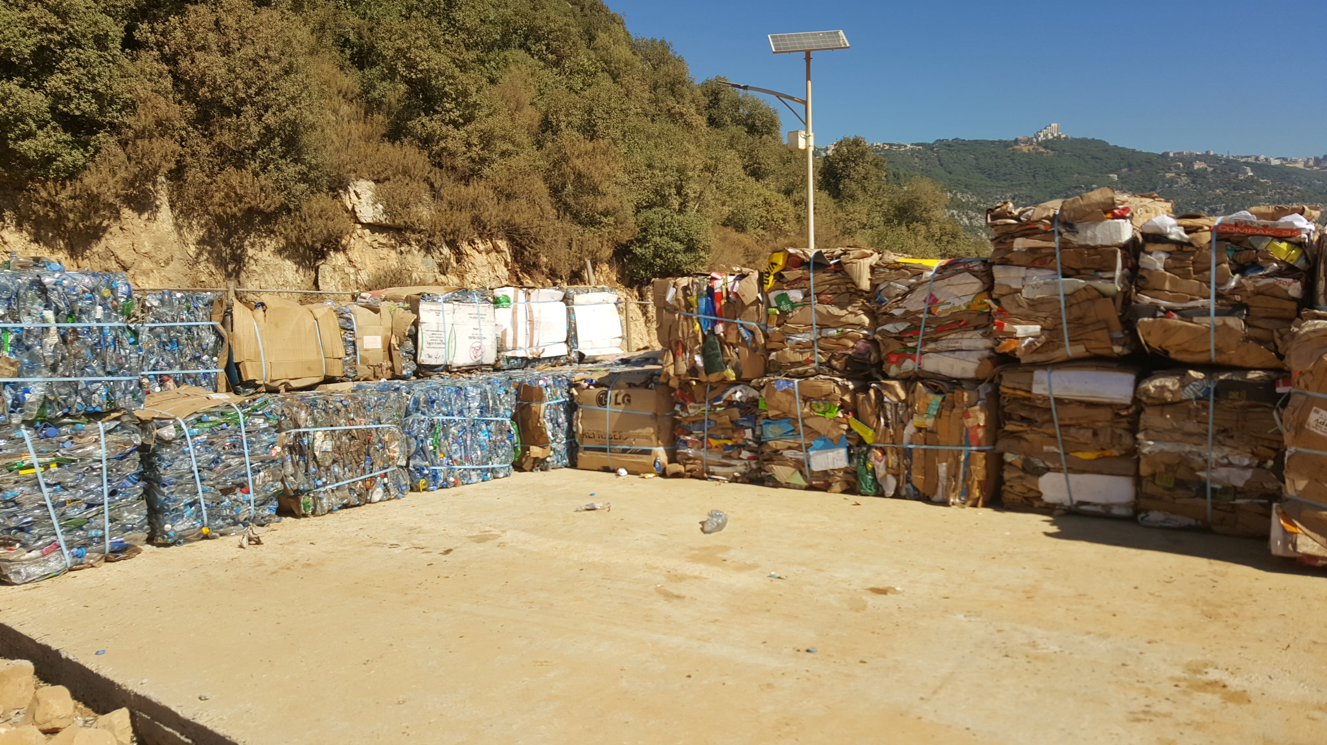
THE BEIT MERY ZERO WASTE RECYCLING PLANT
PET PLASTIC BOTTLES BALES & CARTONS AWAITING SHIPMENT
TO THEIR RESPECTIVE CONVERSION PLANTS

Slide 9
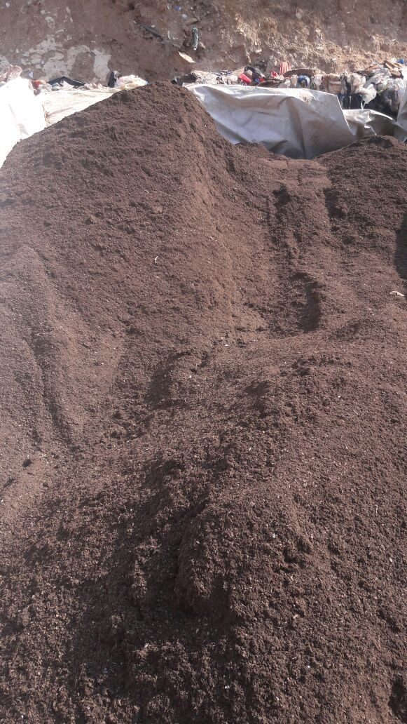
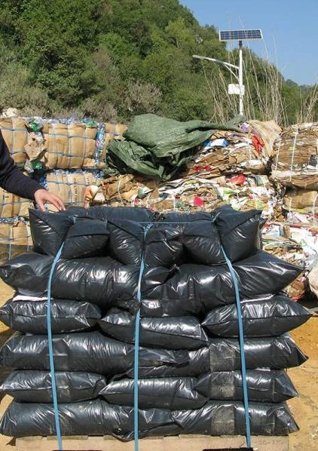
THE BEIT MERY ZERO WASTE RECYCLING PLANT
COMPOST IS REFINED AND BAGGED AND PACKED ON SHIPPING PALLETS

Slide 10
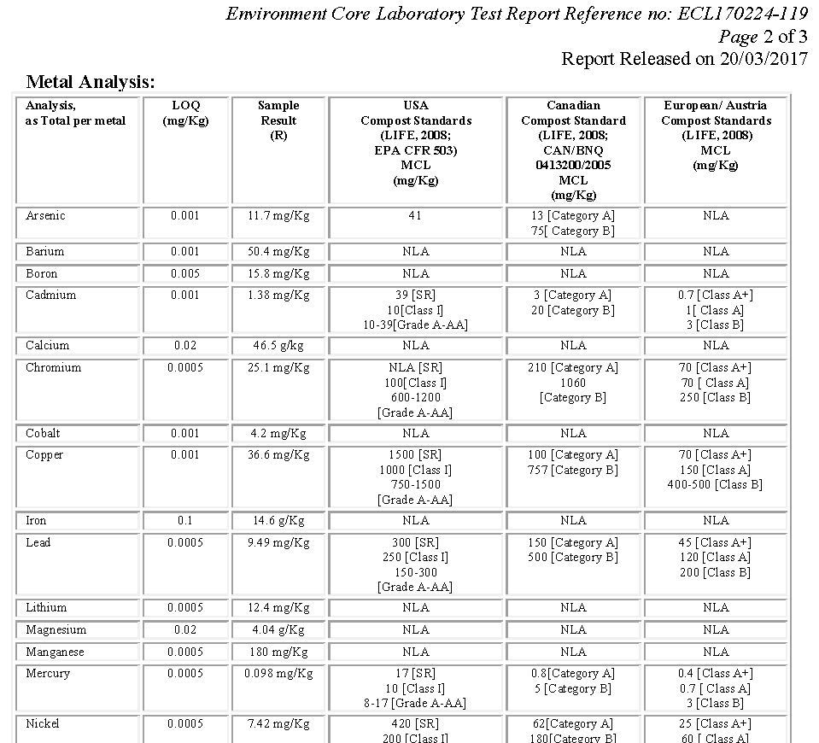
THE BEIT MERY ZERO WASTE RECYCLING PLANT
COMPOST QUALITY IS CONFORM TO EU STANDARD A+ FOR ORGANIC FARMING

Slide 11
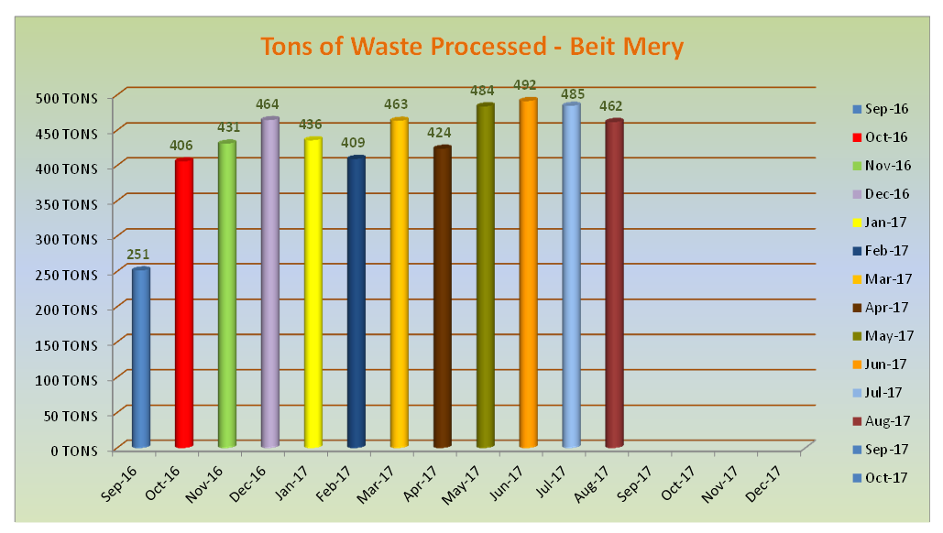
THE BEIT MERY ZERO WASTE RECYCLING PLANT
FROM 8 SEP 2016 TO 29 AUG 2017

Slide 12
THE BEIT MERY ZERO WASTE RECYCLING PLANT
Tin Metals
53,375 KGS
Aluminum
9,047 KGS
Cartons
80,095 KGS
PET Plastics
74,116 KGS
Transparent Glass
77,540 KGS
Green Glass
40,806 KGS
HDPE (crates)
30,647 KGS
Ecoboard Plastics
48,310 KGS
RECYCLABLES PUT BACK INTO THE RECYCLING INDUSTRIES
FROM 8 SEP 2016 TO 5 AUG 2017

Slide 13
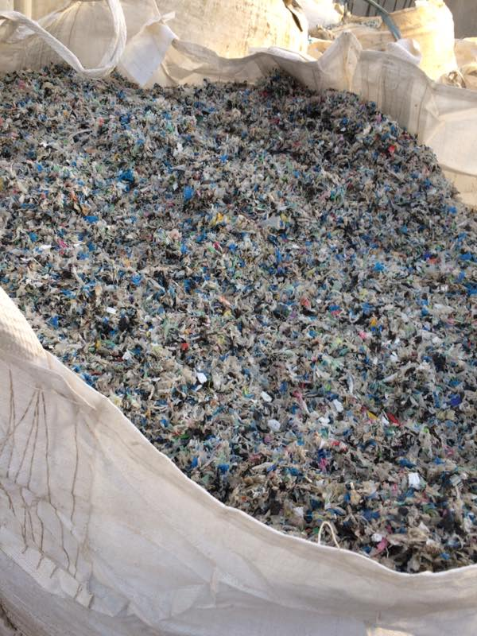
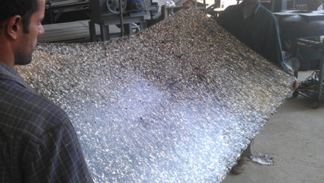
THE BEIT MERY ZERO WASTE RECYCLING PLANT
SO CALLED INERT MATERIALS ARE SHREDDED AND MANUFACTURED INTO ECOBOARDS

Slide 14
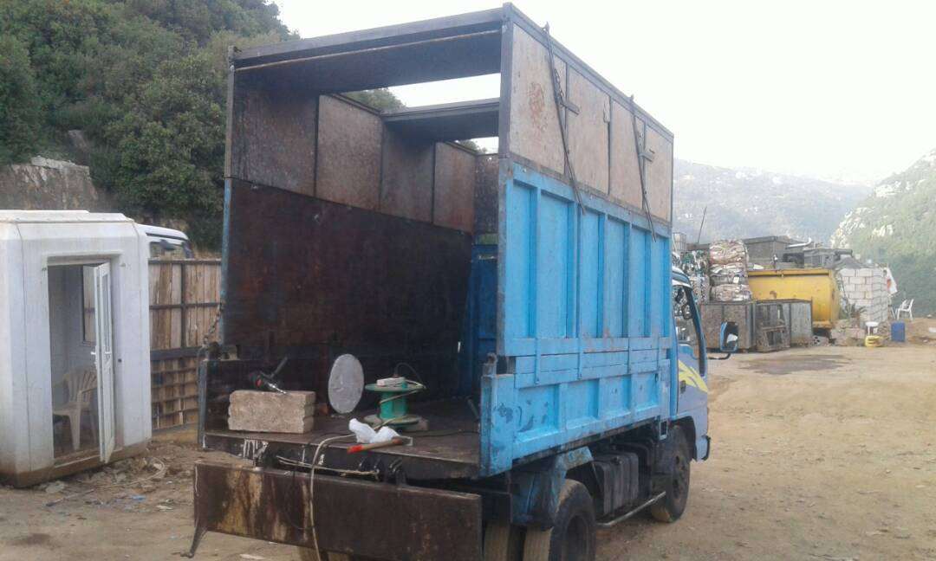
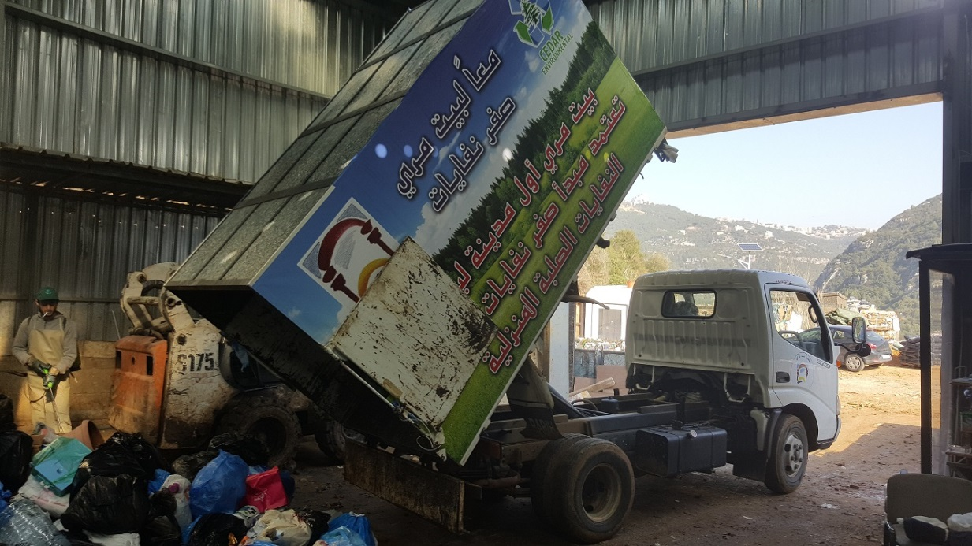
THE BEIT MERY ZERO WASTE RECYCLING PLANT
ECOBOARDS ARE USED TO INCREASE THE VOLUME OF THE GARBAGE TRUCKS

Slide 15
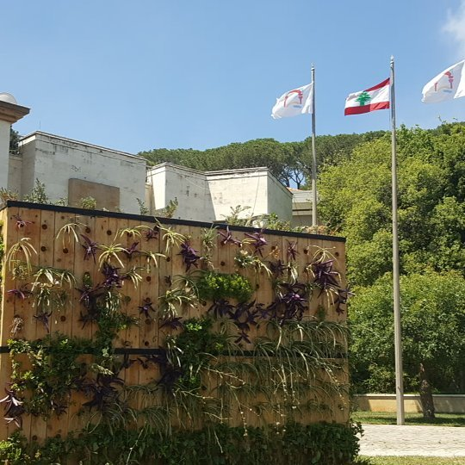
THE BEIT MERY ZERO WASTE RECYCLING PLANT
ECOBOARDS ARE ALSO USED TO MAKE VERTICAL GREENWALLS – BEIT MERY MUNICIPALITY

Slide 16
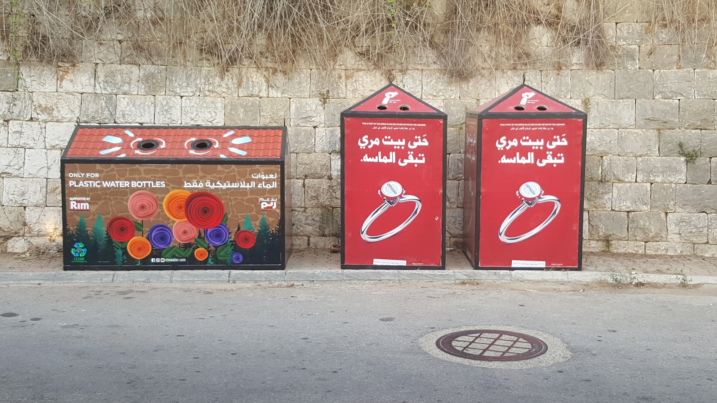
THE BEIT MERY ZERO WASTE RECYCLING PLANT
ECOBOARDS ARE ALSO USED TO MAKE STREET RECYCLING BINS – BEIT MERY SOUK ROAD

Slide 17
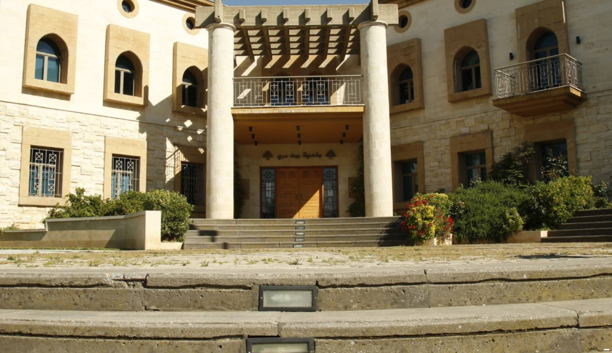
THE DREAM OF ZERO WASTE HAS BECOME A REALITY IN BEIT MERY

